Slide 1
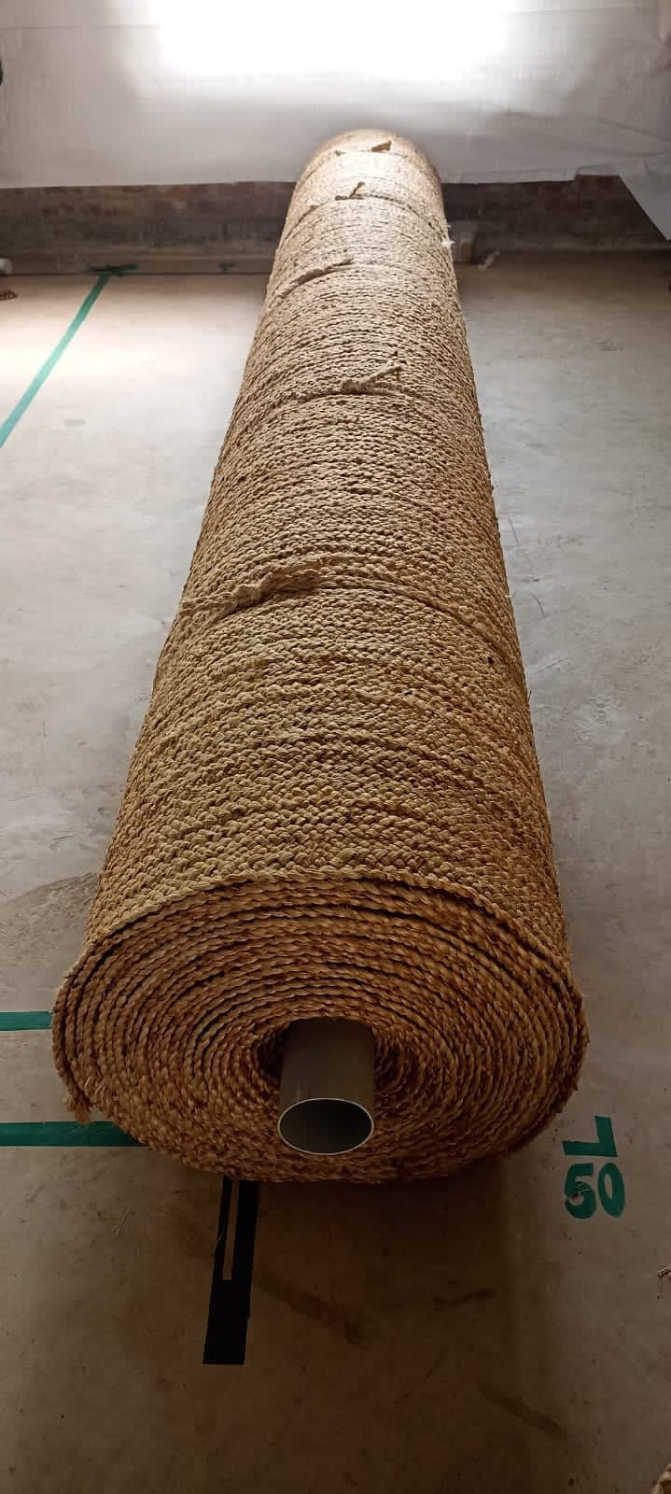
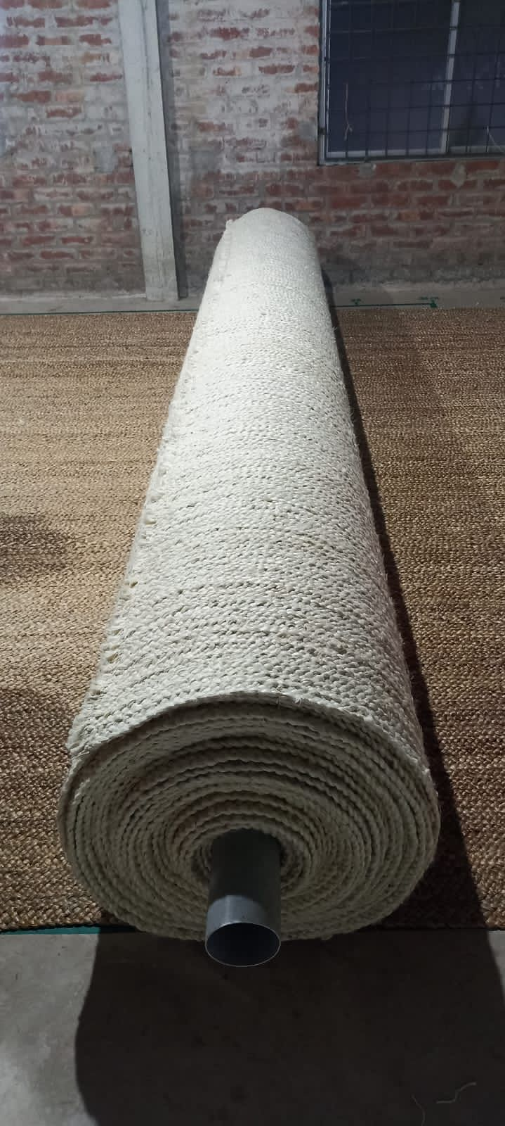
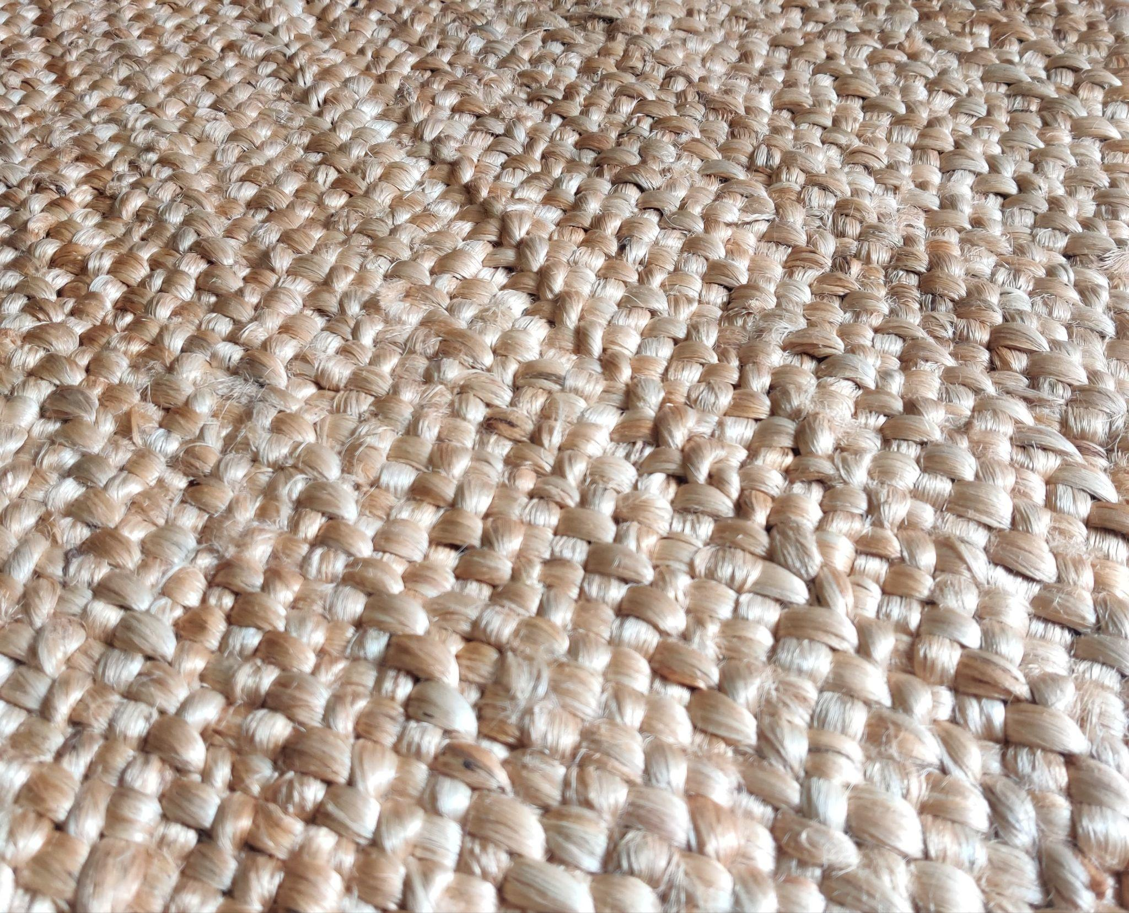
HANDMADE JUTE RUGS
PRODUCT CODE : MKT-H1253
MKT-H1253B
TYPE - 5 PLY (1Inc Thick) ROLL
MATERIAL DESC:- 100% JUTE
100% HAND STITCHED
WE CAN MAKE CUSTOM DESIGN,
COLOUR AND SIZE

Slide 2
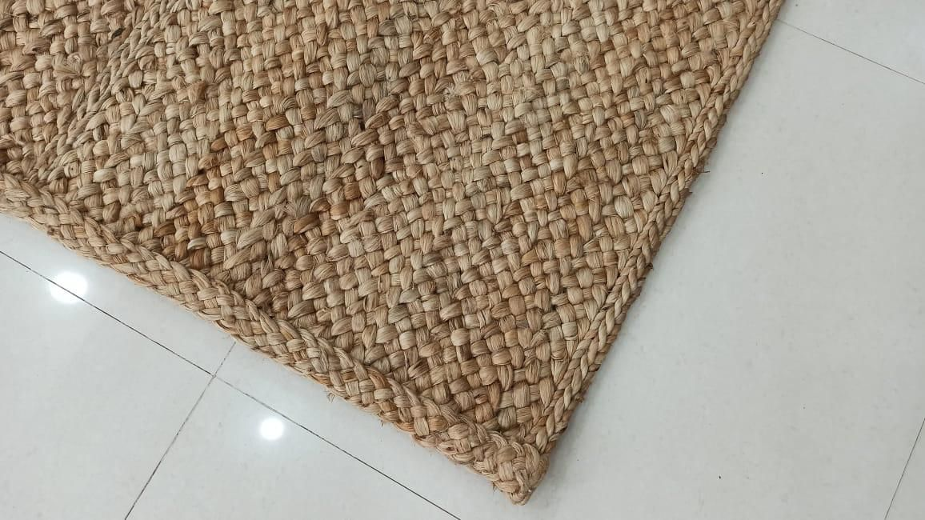
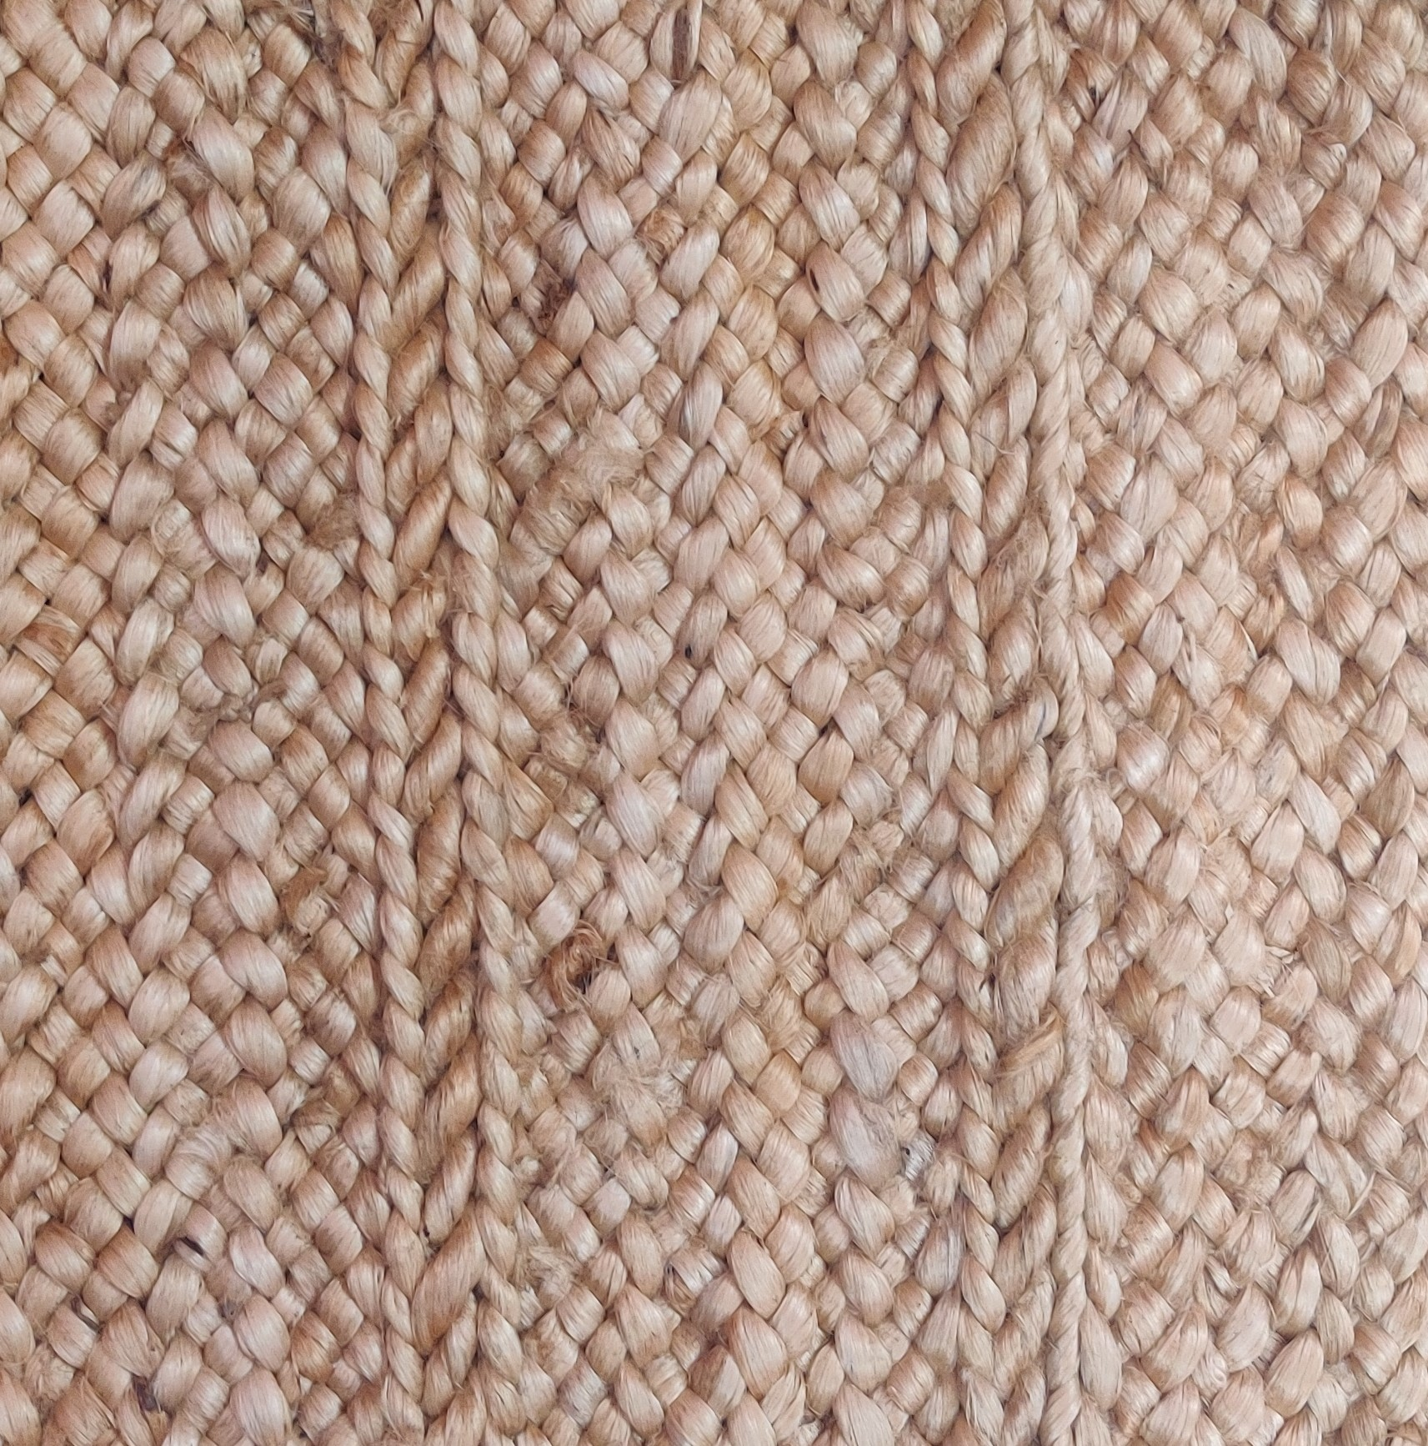
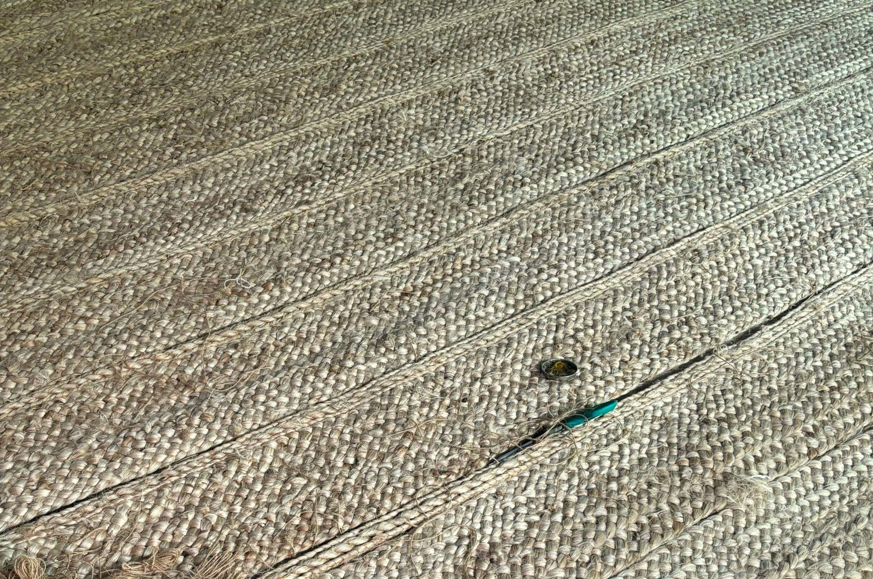
HANDMADE JUTE RUGS
PRODUCT CODE : MKT-H1255
TYPE - 5 PLY (2 Inch Thick) WITH 2 PLY PLATT
MATERIAL :- 100% JUTE
100% HAND STITCHED
WE CAN MAKE CUSTOM DESIGN,COLOUR AND SIZE

Slide 3
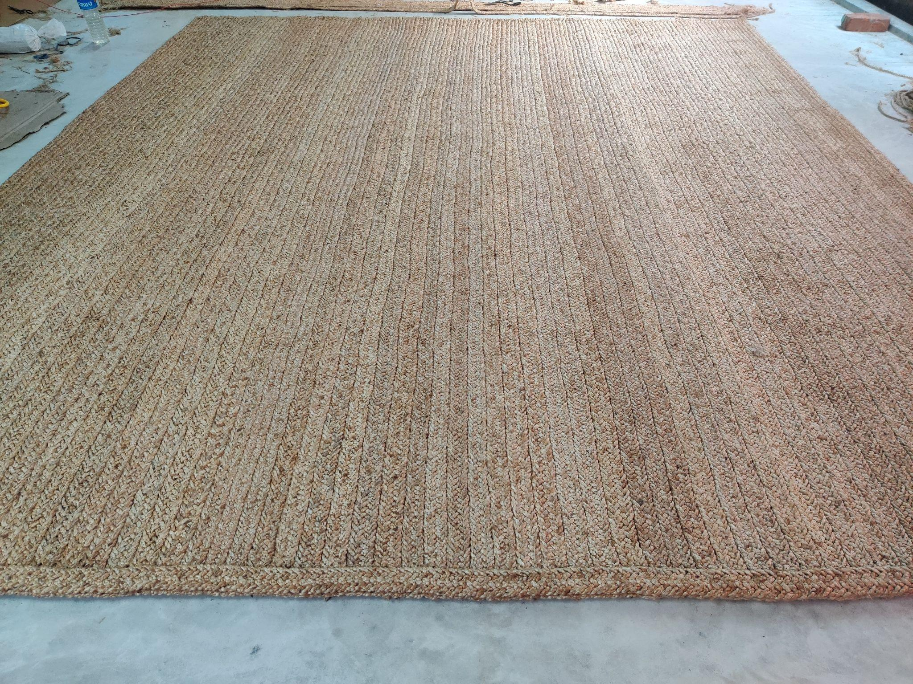
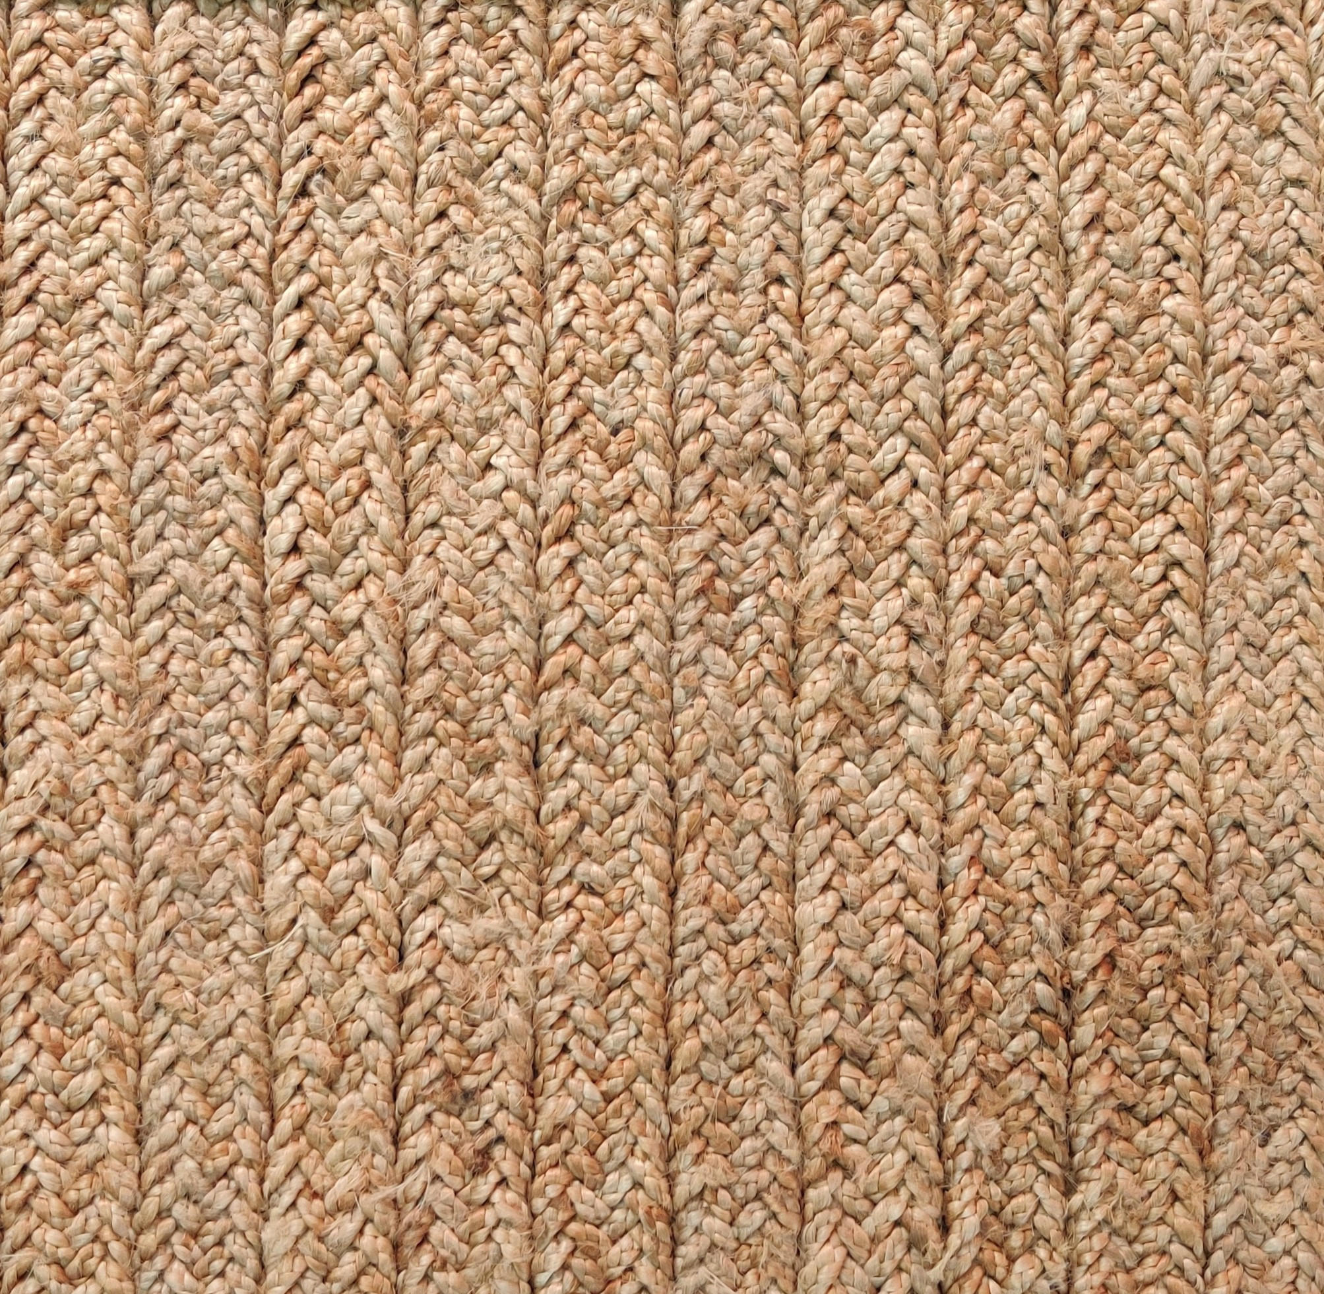
HANDMADE JUTE RUGS
PRODUCT CODE : MKT-1290
TYPE - DOUBLE BRAIDED ( 9PLY -1.5Inc Thick)
MATERIAL :- 100% JUTE
100% HAND STITCHED
WE CAN MAKE CUSTOM DESIGN,COLOUR AND SIZE

Slide 4
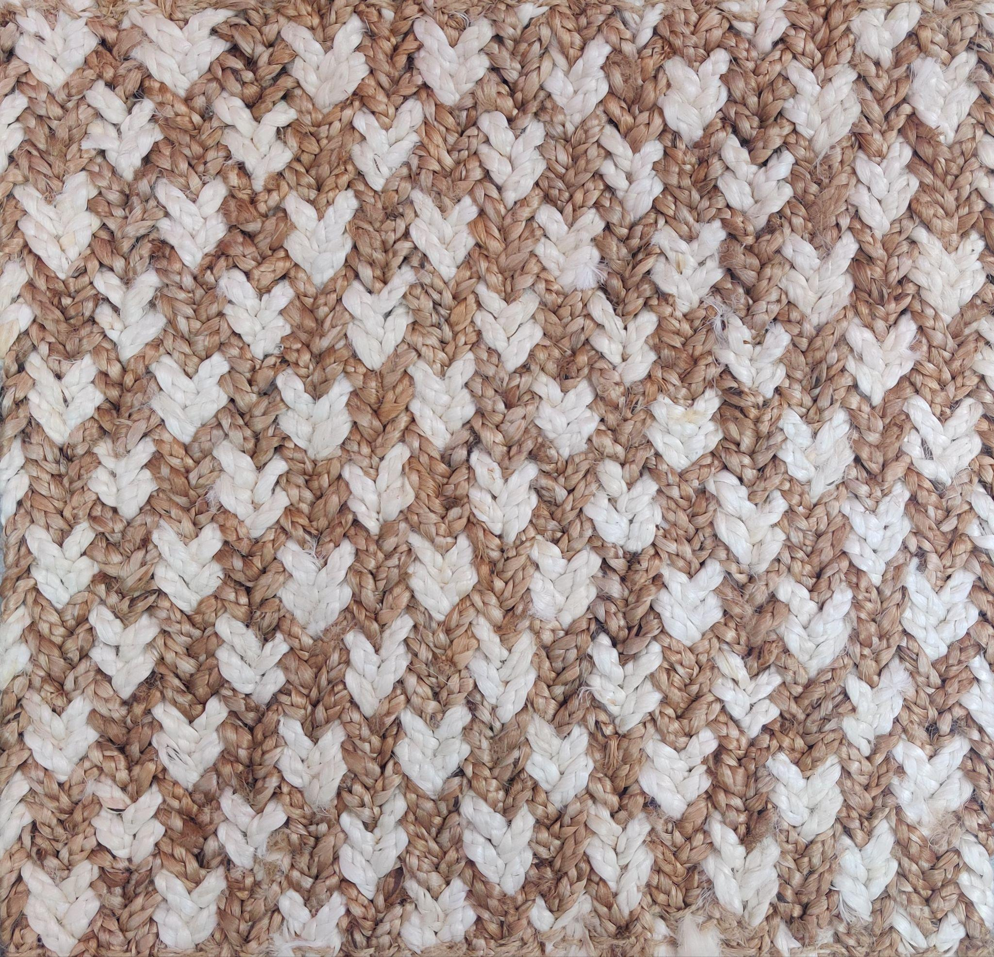
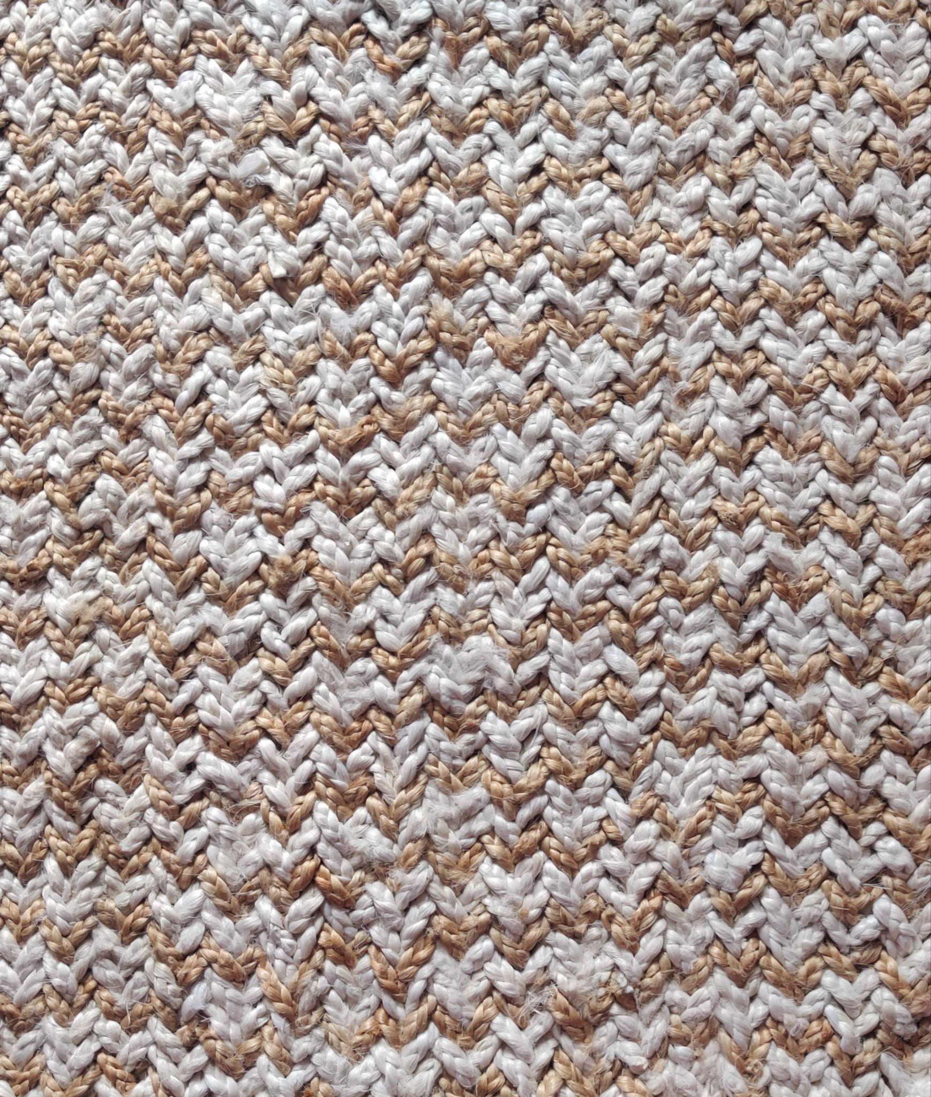
HANDMADE JUTE RUGS
PRODUCT CODE : MKT-1292
TYPE - DOUBLE BRAIDED (10PLY – 1.5Inc)
MATERIAL :- 100% JUTE
100% HAND STITCHED
WE CAN MAKE CUSTOM DESIGN,COLOUR AND SIZE

Slide 5
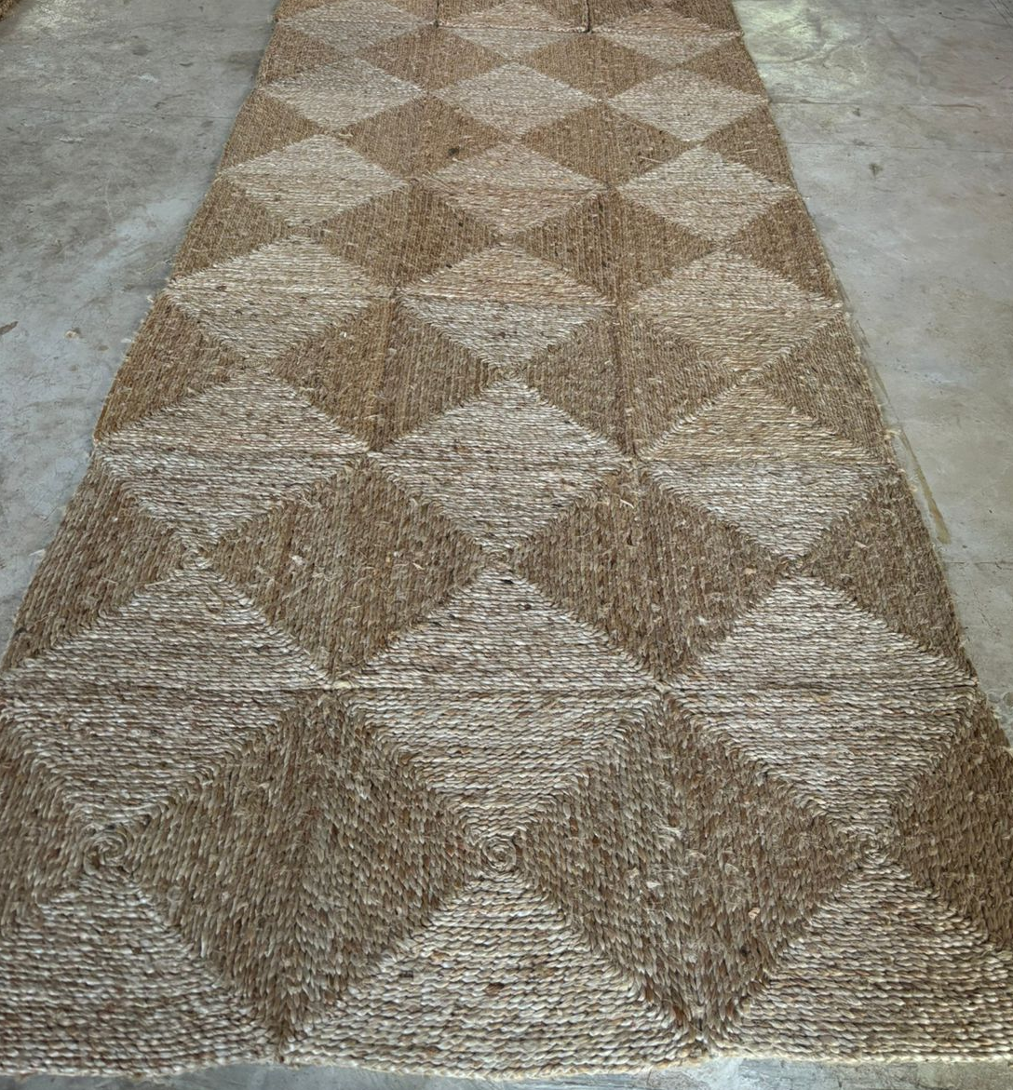
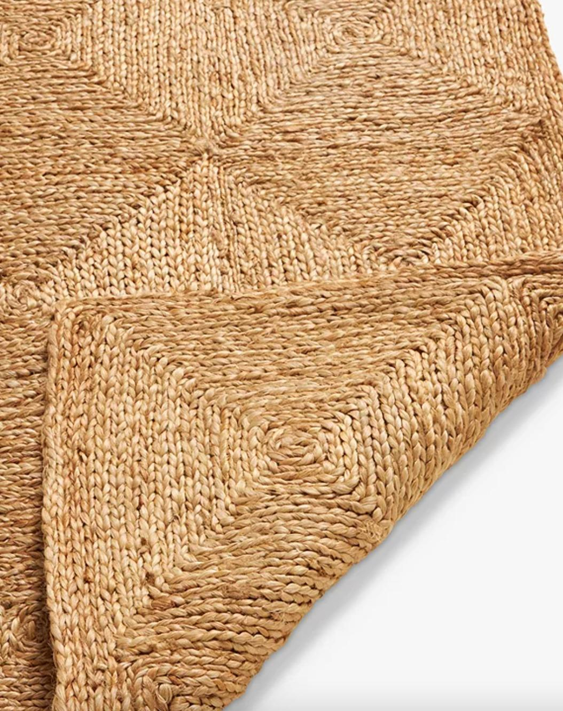
HANDMADE JUTE RUGS
PRODUCT CODE : MKT-1232
TYPE - BOX DESIGN RUG
(30X30CM EACH BOX)
MATERIAL DESC:- 100% JUTE
100% HAND STITCHED
WE CAN MAKE CUSTOM DESIGN,COLOUR AND SIZE

Slide 6
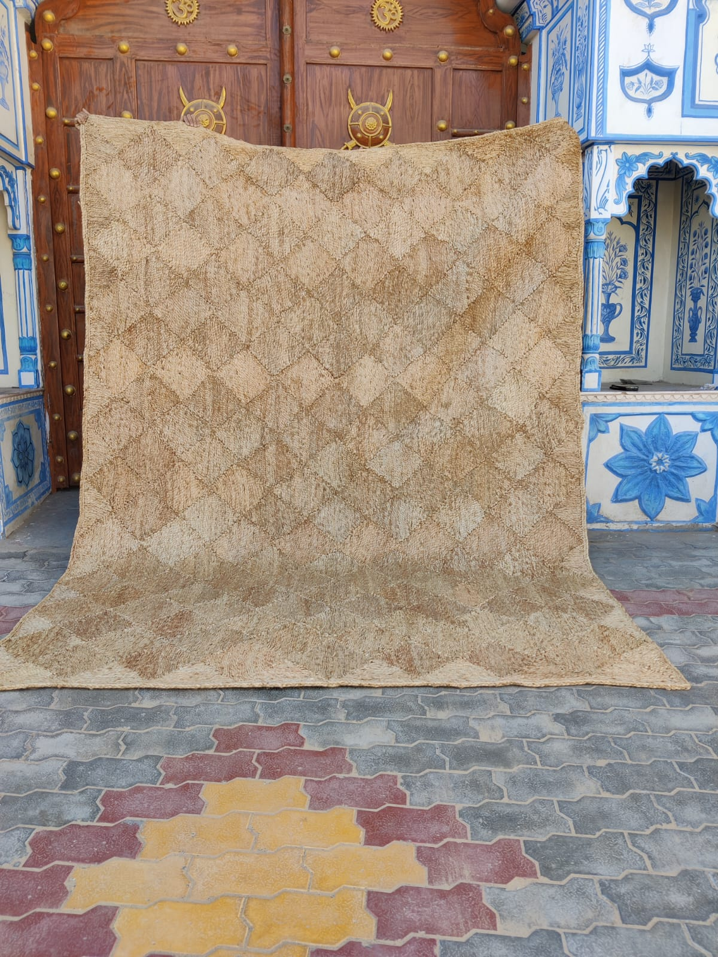
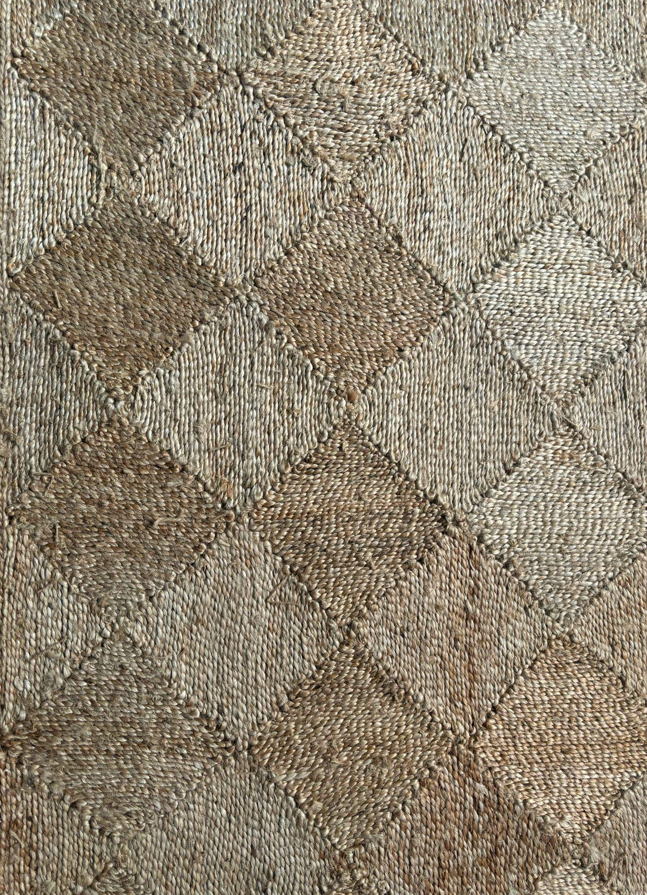
HANDMADE JUTE RUGS
PRODUCT CODE : MKT-1235
TYPE - DIAMOND FILL
MATERIAL :- 100% JUTE
100% HAND STITCHED
WE CAN MAKE CUSTOM DESIGN,COLOUR AND SIZE

Slide 7
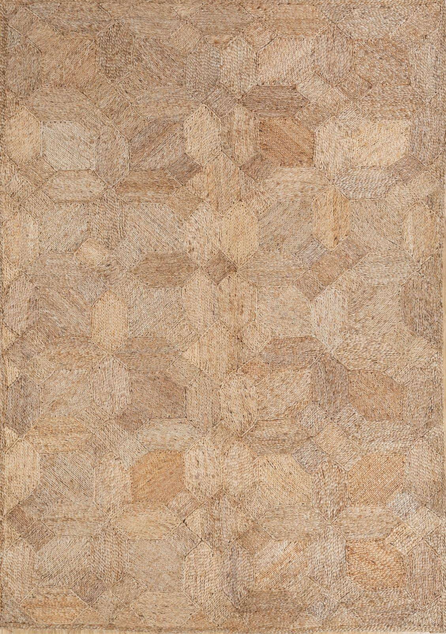
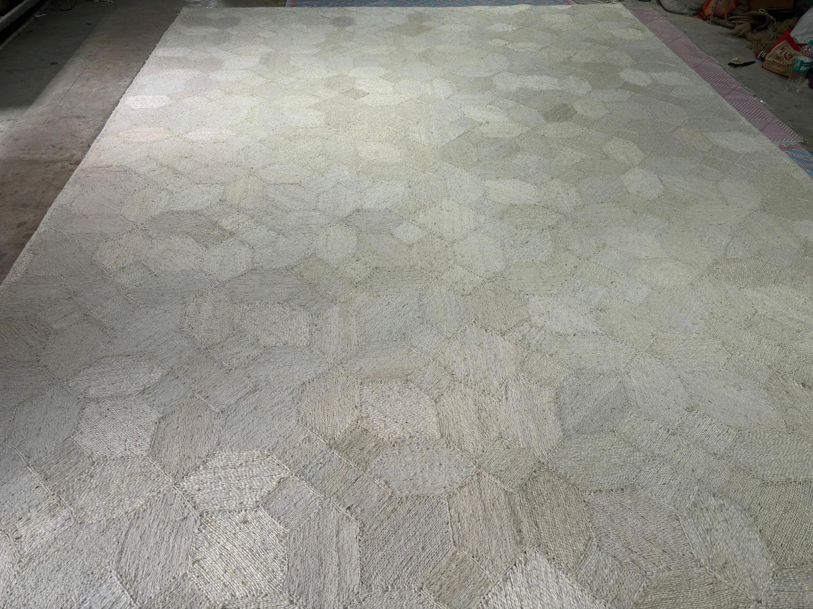
HANDMADE JUTE RUGS
PRODUCT CODE : MKT-1275 & 1275B
TYPE – PATERN FILL
MATERIAL :- 100% JUTE
100% HAND STITCHED
WE CAN MAKE CUSTOM DESIGN,COLOUR AND SIZE

Slide 8
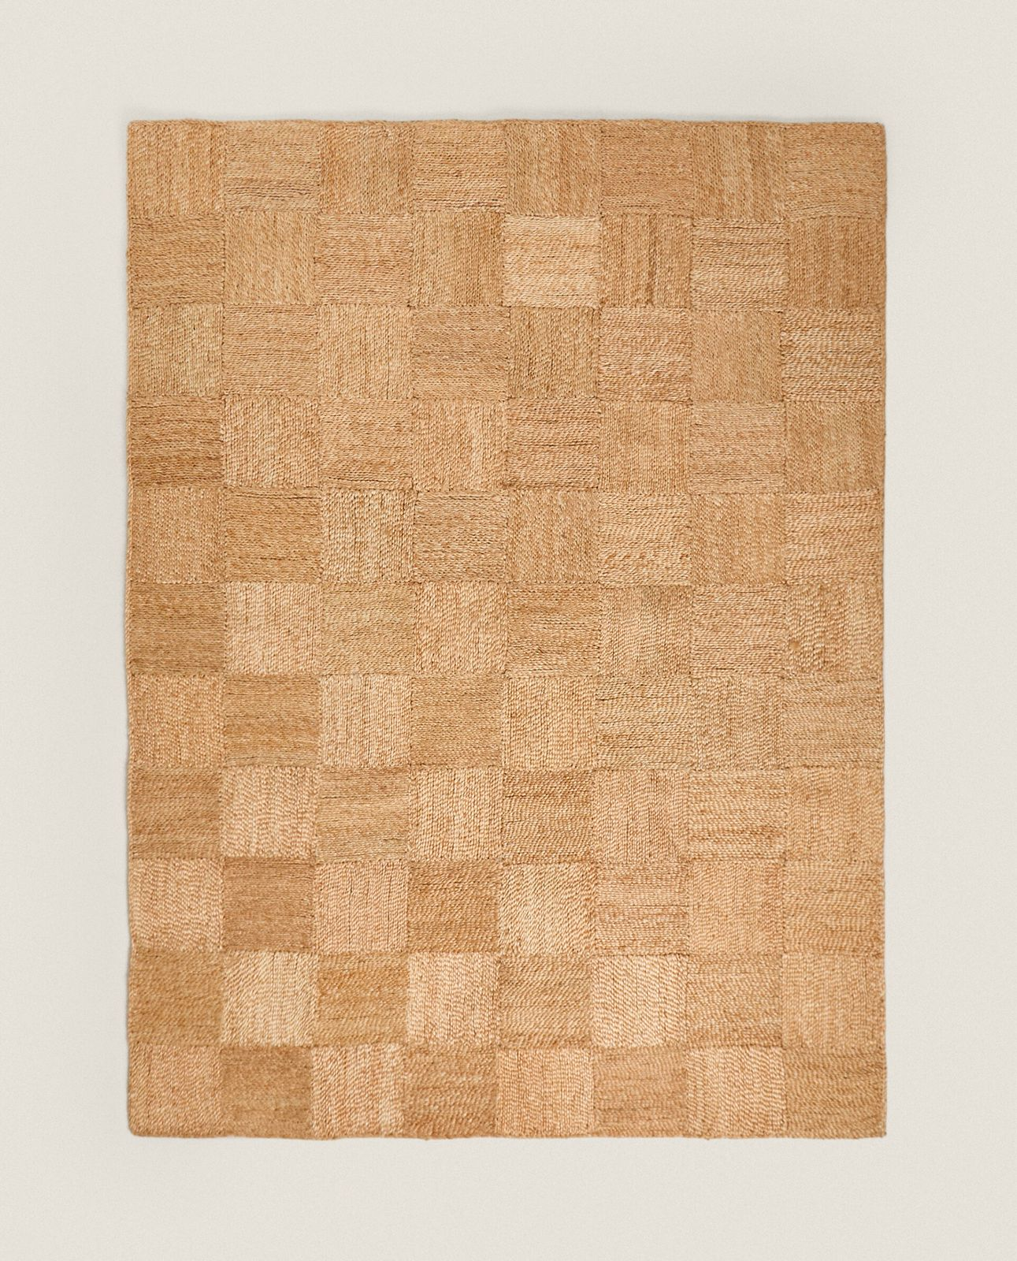
HANDMADE JUTE RUGS
PRODUCT CODE : MKT-1239
TYPE – SQURE FILL
MATERIAL :- 100% JUTE
100% HAND STITCHED
WE CAN MAKE CUSTOM DESIGN,COLOUR AND SIZE

Slide 9
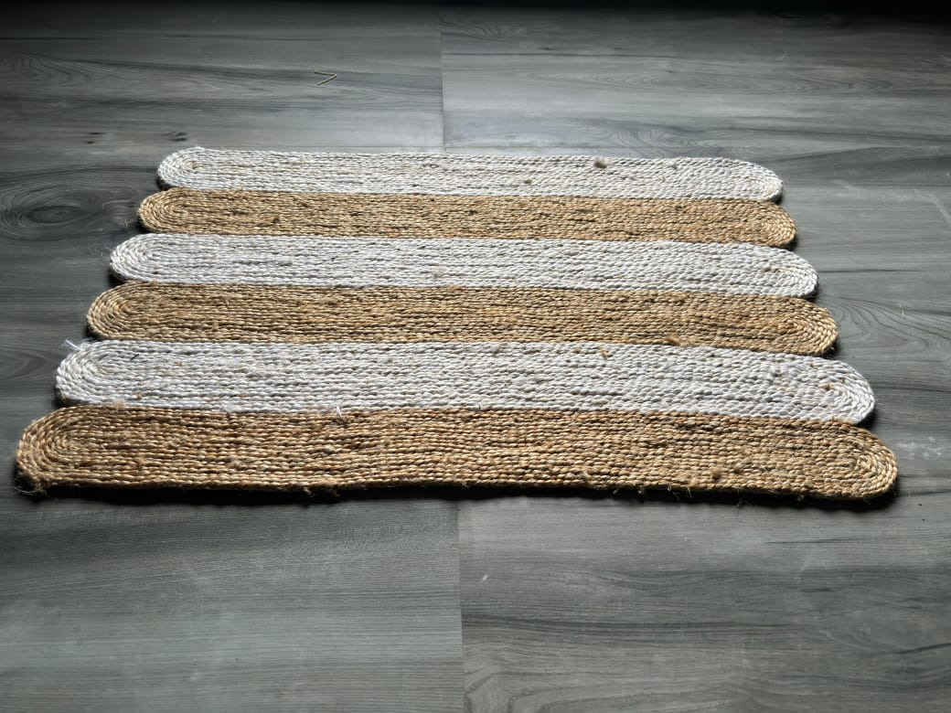
HANDMADE JUTE RUGS
PRODUCT CODE : MKT-1245
TYPE - RECTANGLE OVAL
MATERIAL :- 100% JUTE
100% HAND STITCHED
WE CAN MAKE CUSTOM DESIGN,COLOUR AND SIZE

Slide 10
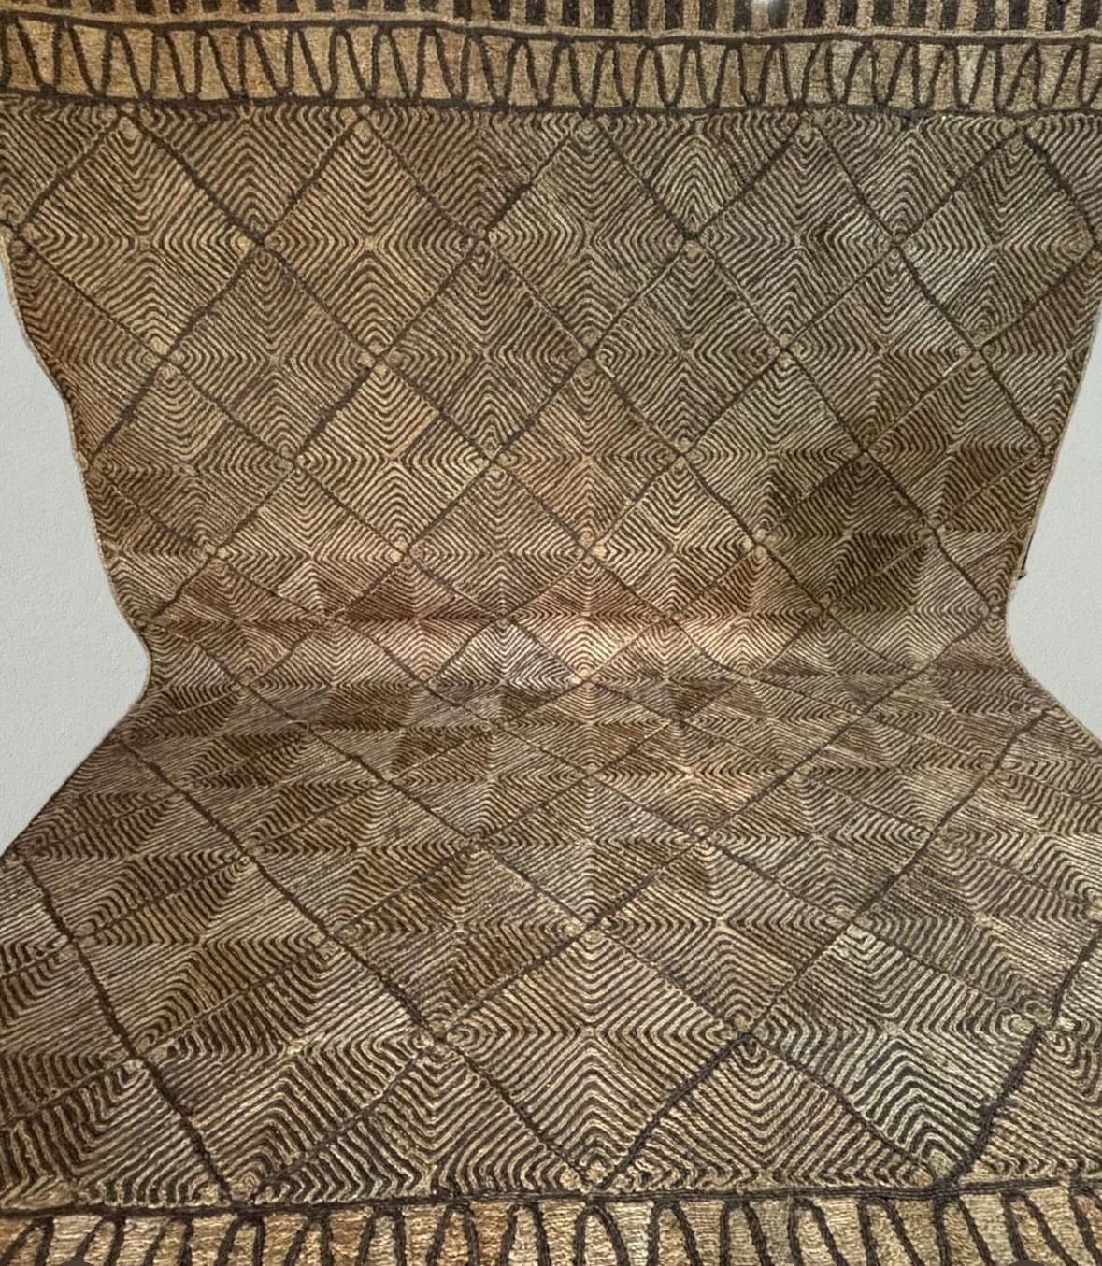
HANDMADE JUTE RUGS
PRODUCT CODE : MKT-1270
TYPE - PATTERN FILL
MATTERIAL :- 100% JUTE
100% HAND STITCHED
WE CAN MAKE CUSTOM DESIGN,COLOUR AND SIZE

Slide 11
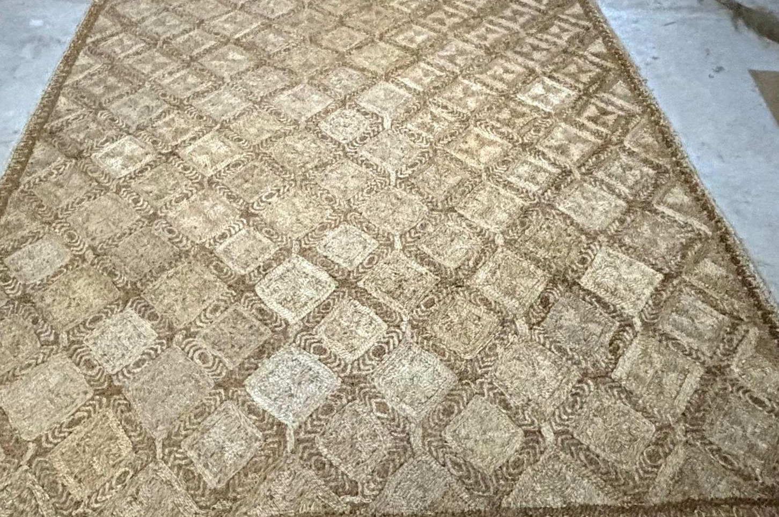
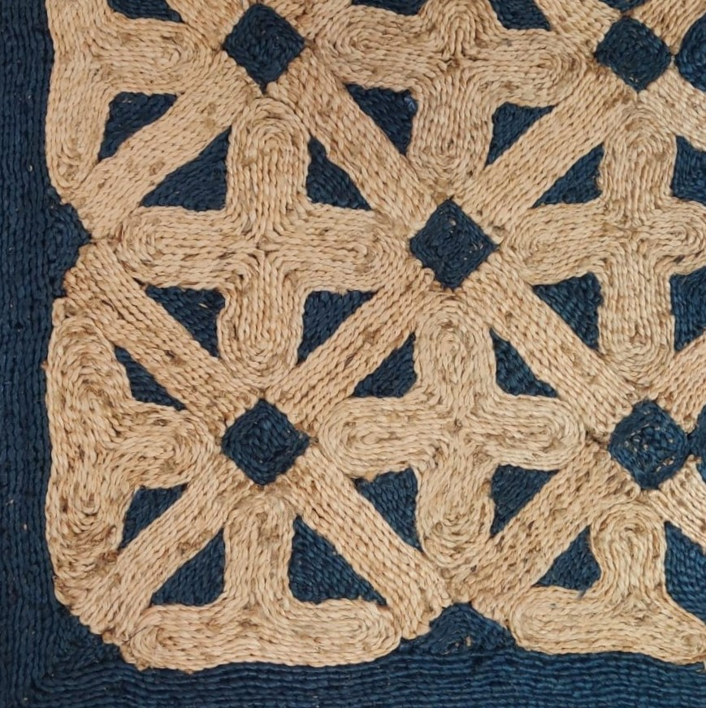
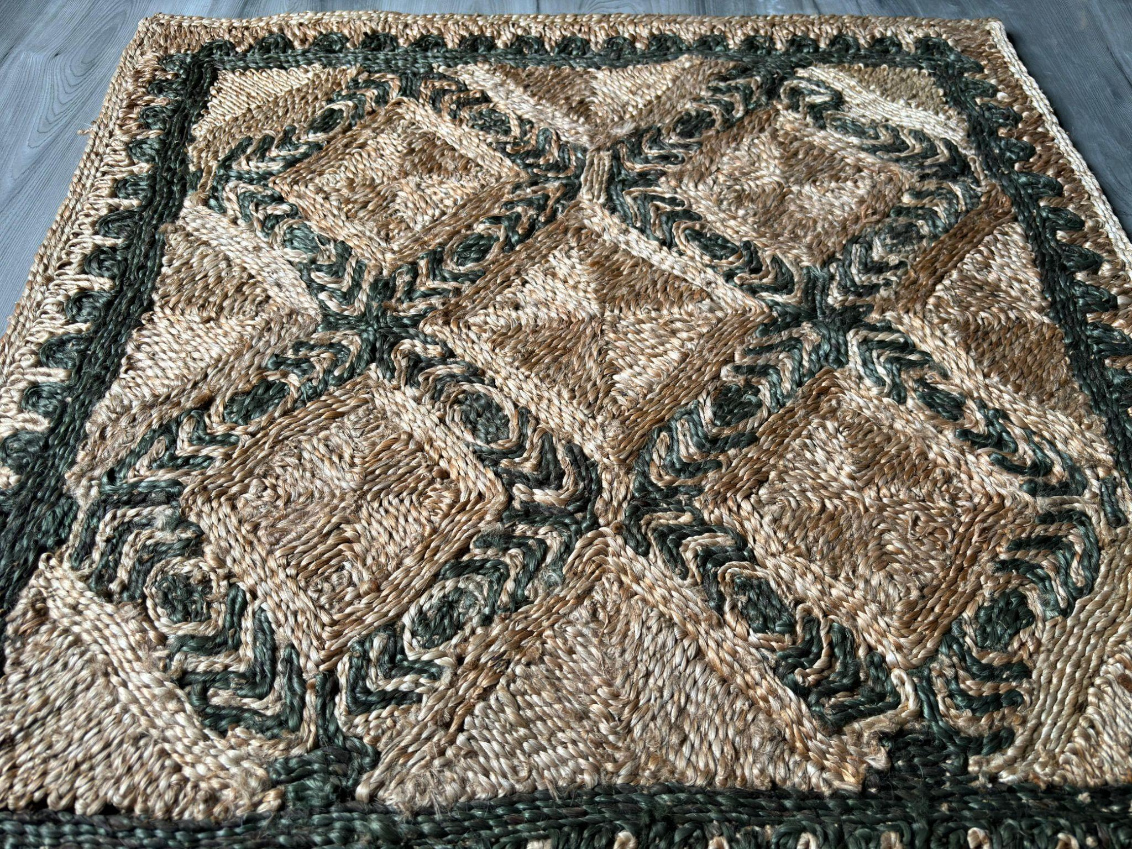
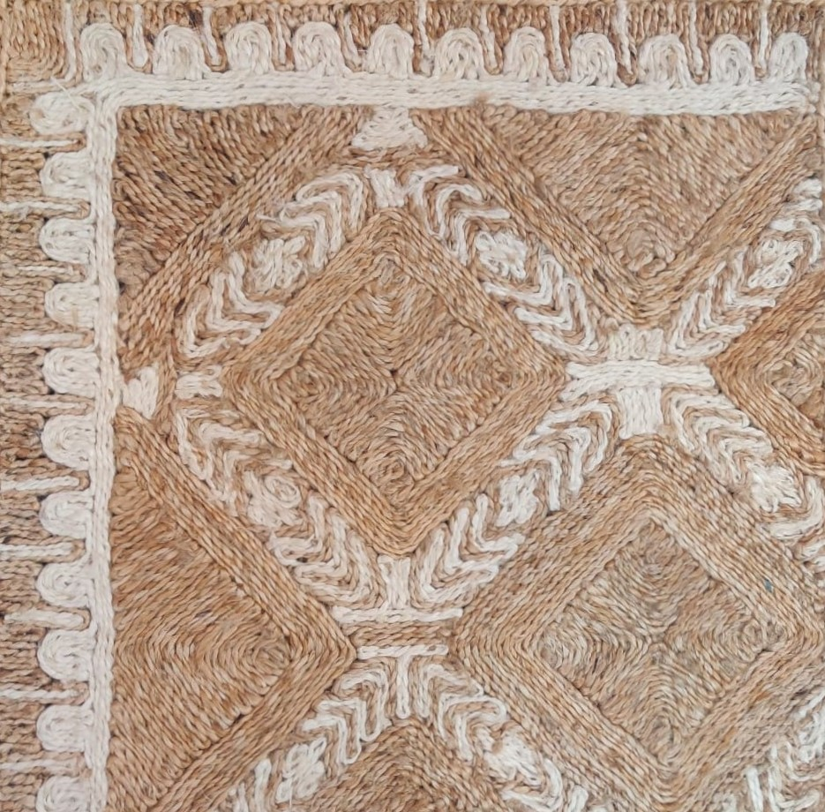
HANDMADE JUTE RUGS
PRODUCT CODE : MKT-1277
TYPE - PATTERN FILL
MATERIAL :- 100% JUTE
100% HAND STITCHED
WE CAN MAKE CUSTOM DESIGN,COLOUR AND SIZE

Slide 12
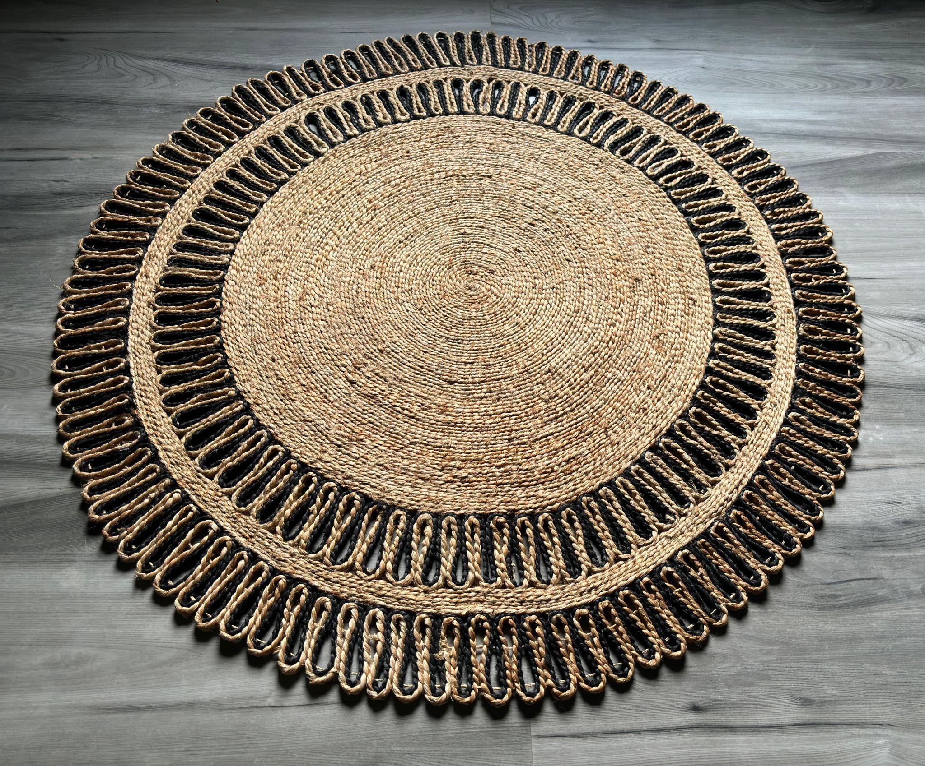
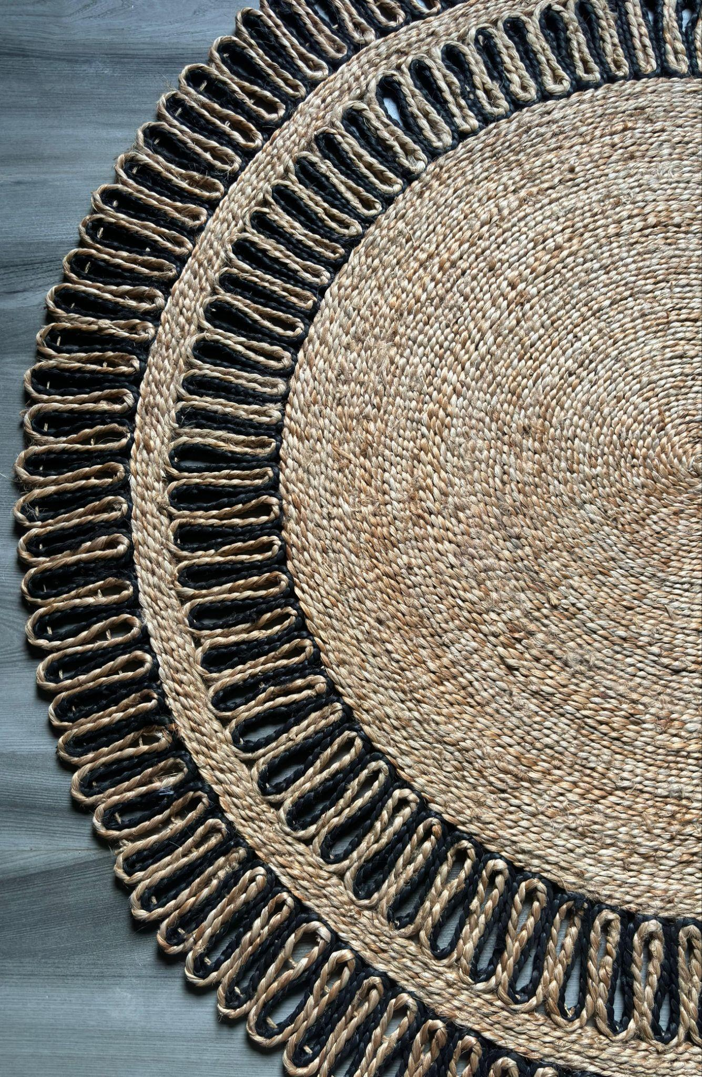
HANDMADE JUTE RUGS
PRODUCT CODE : MKT-1212
TYPE - ROUND
MATERIAL :- 100% JUTE
100% HAND STITCHED
WE CAN MAKE CUSTOM DESIGN,COLOUR AND SIZE

Slide 13
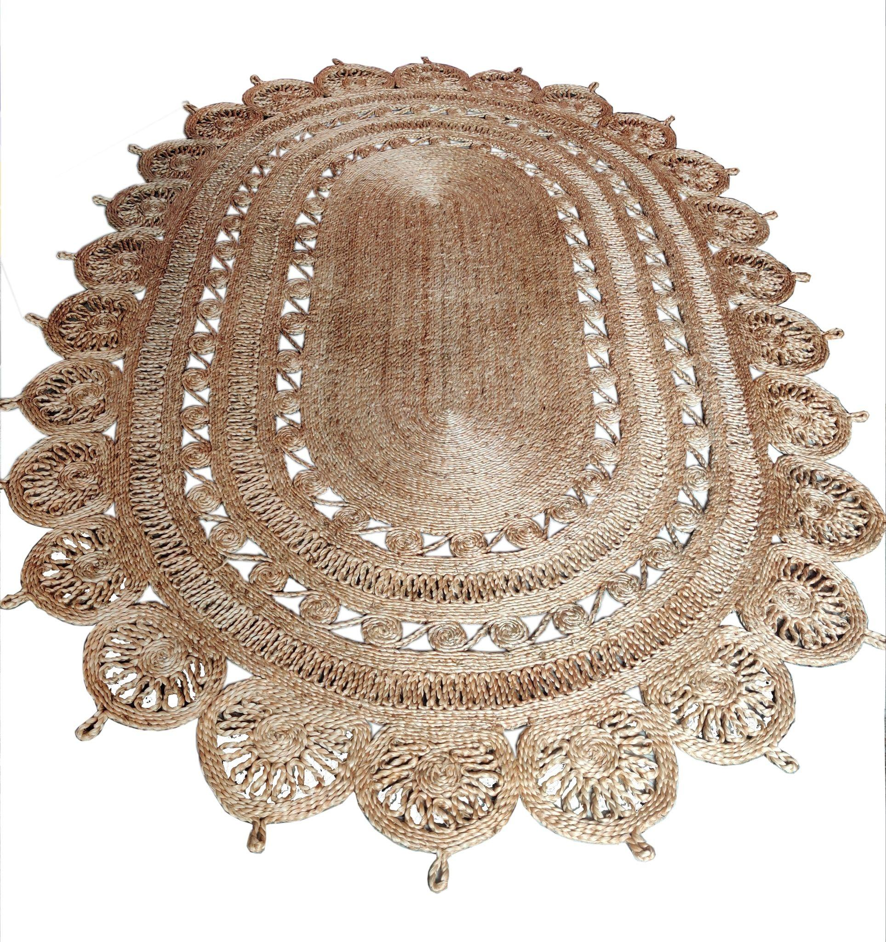
HANDMADE JUTE RUGS
PRODUCT CODE : MKT-1241
TYPE - OVAL
MATERIAL :- 100% JUTE
100% HAND STITCHED
WE CAN MAKE CUSTOM DESIGN,COLOUR AND SIZE

Slide 14
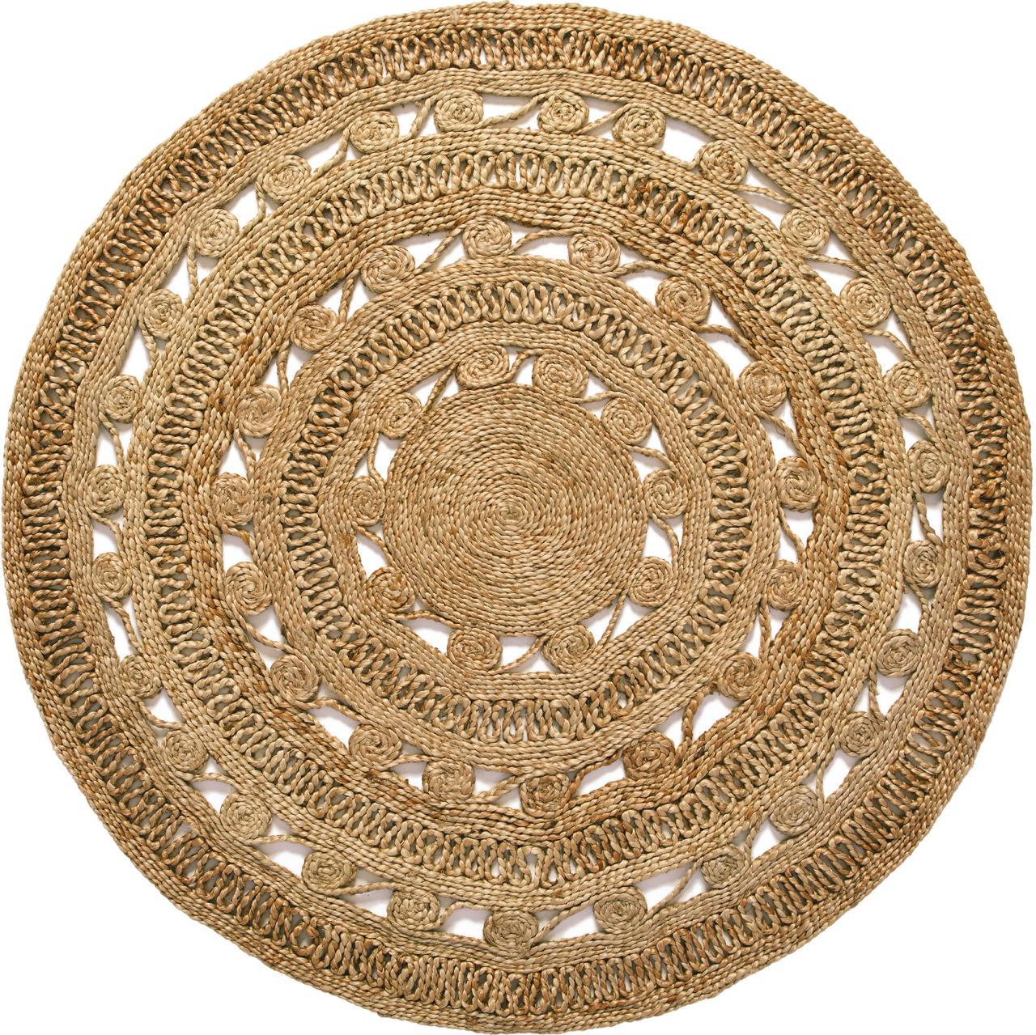
HANDMADE JUTE RUGS
PRODUCT CODE : MKT-1210
TYPE - ROUND
MATTERIAL :- 100% JUTE
100% HAND STITCHED
WE CAN MAKE CUSTOM DESIGN,COLOUR AND SIZE

Slide 15
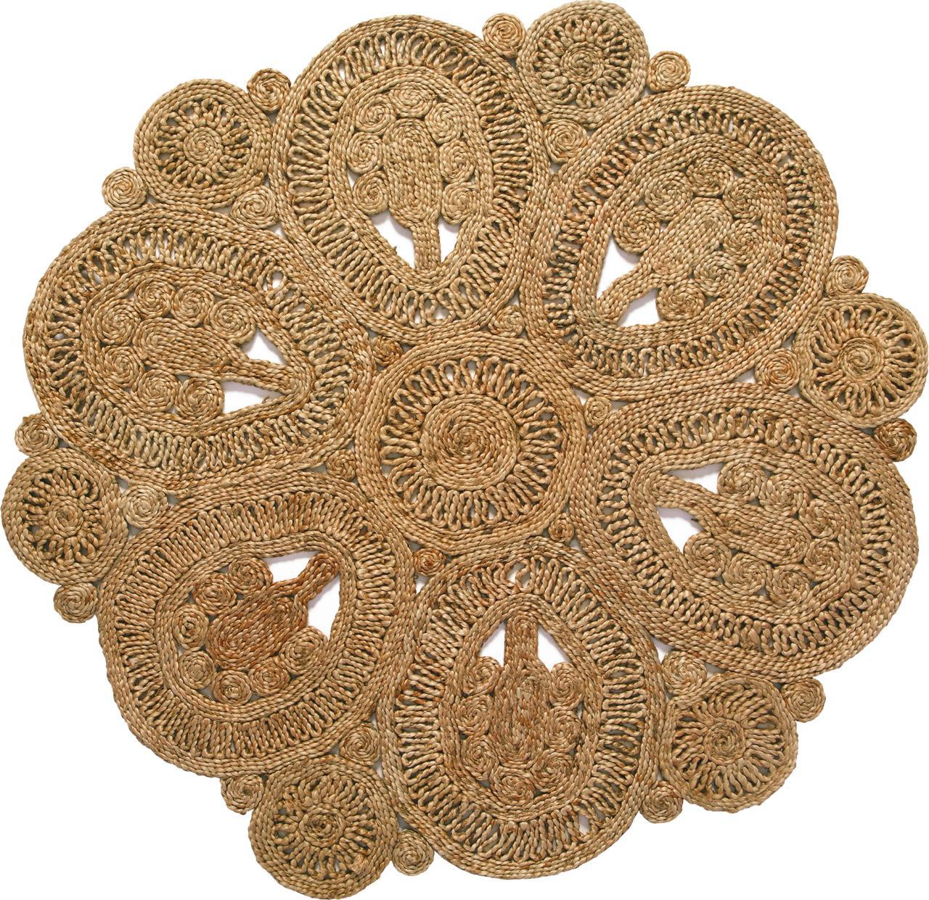
HANDMADE JUTE RUGS
PRODUCT CODE : MKT-1215
TYPE - ROUND
MATERIAL :- 100% JUTE
100% HAND STITCHED
WE CAN MAKE CUSTOM DESIGN,COLOUR AND SIZE

Slide 16
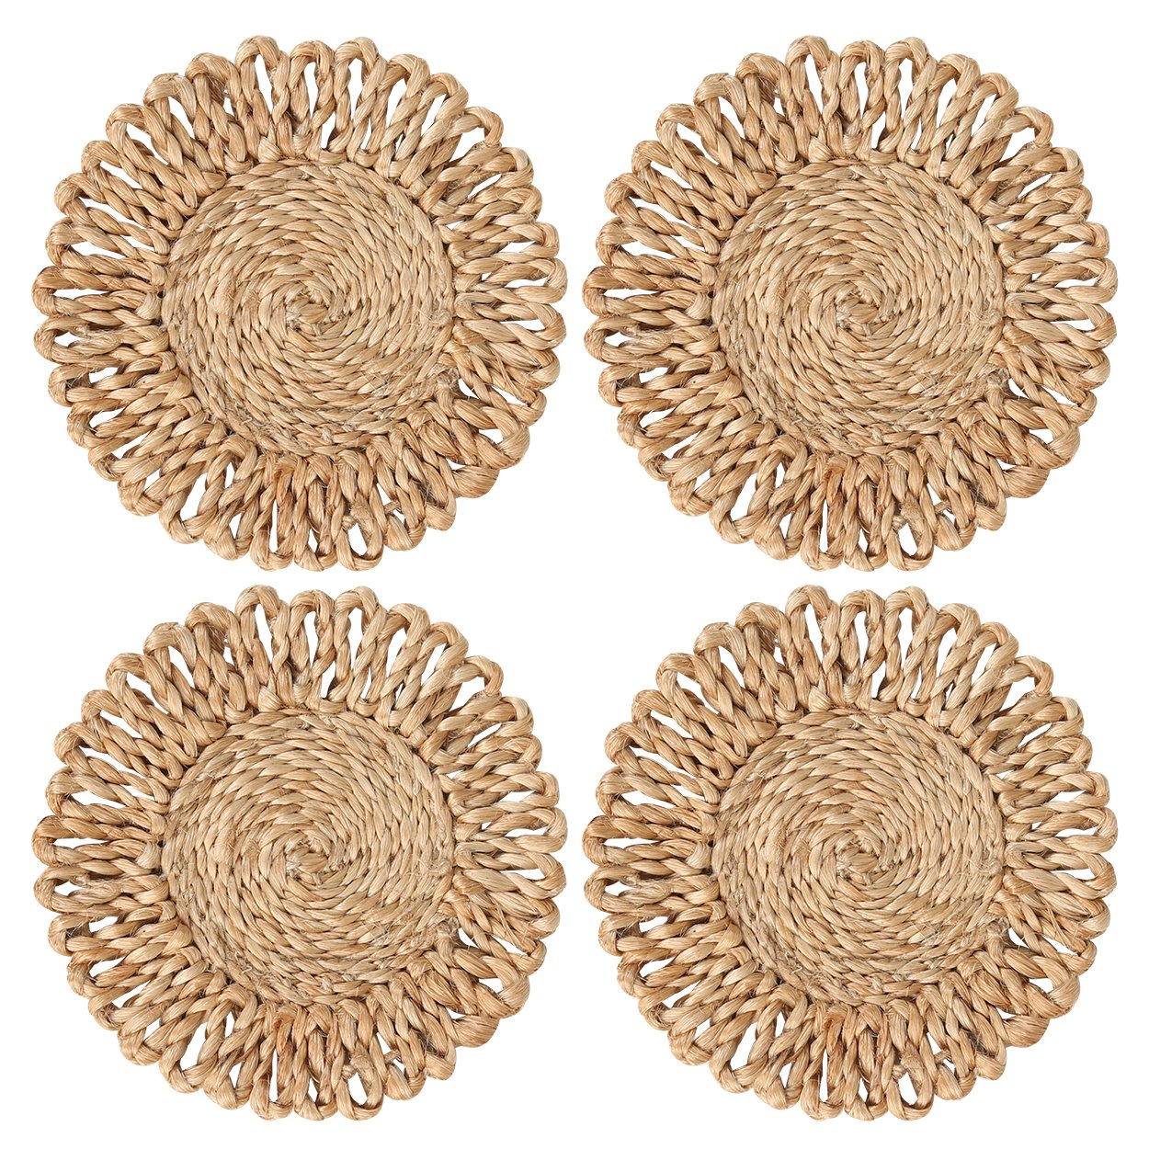
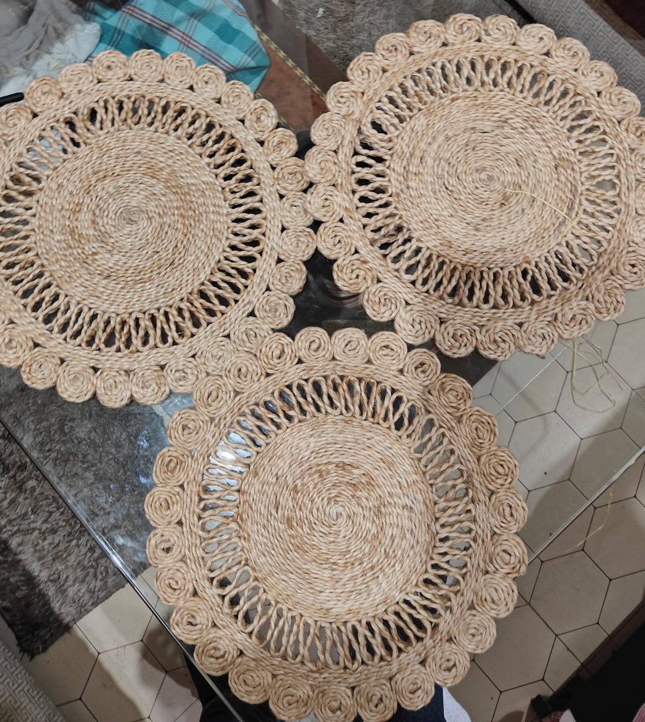
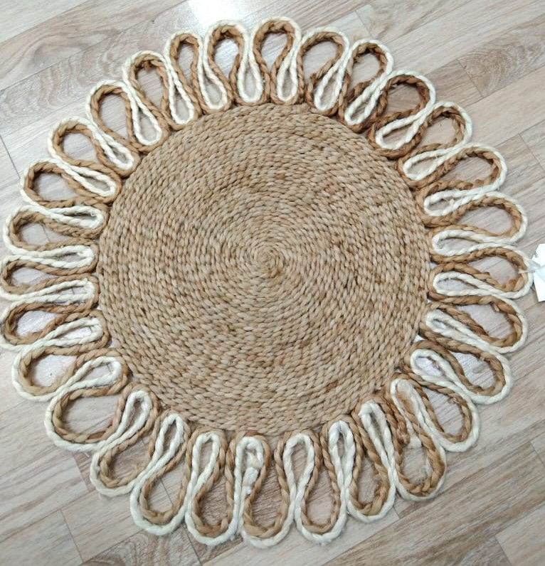
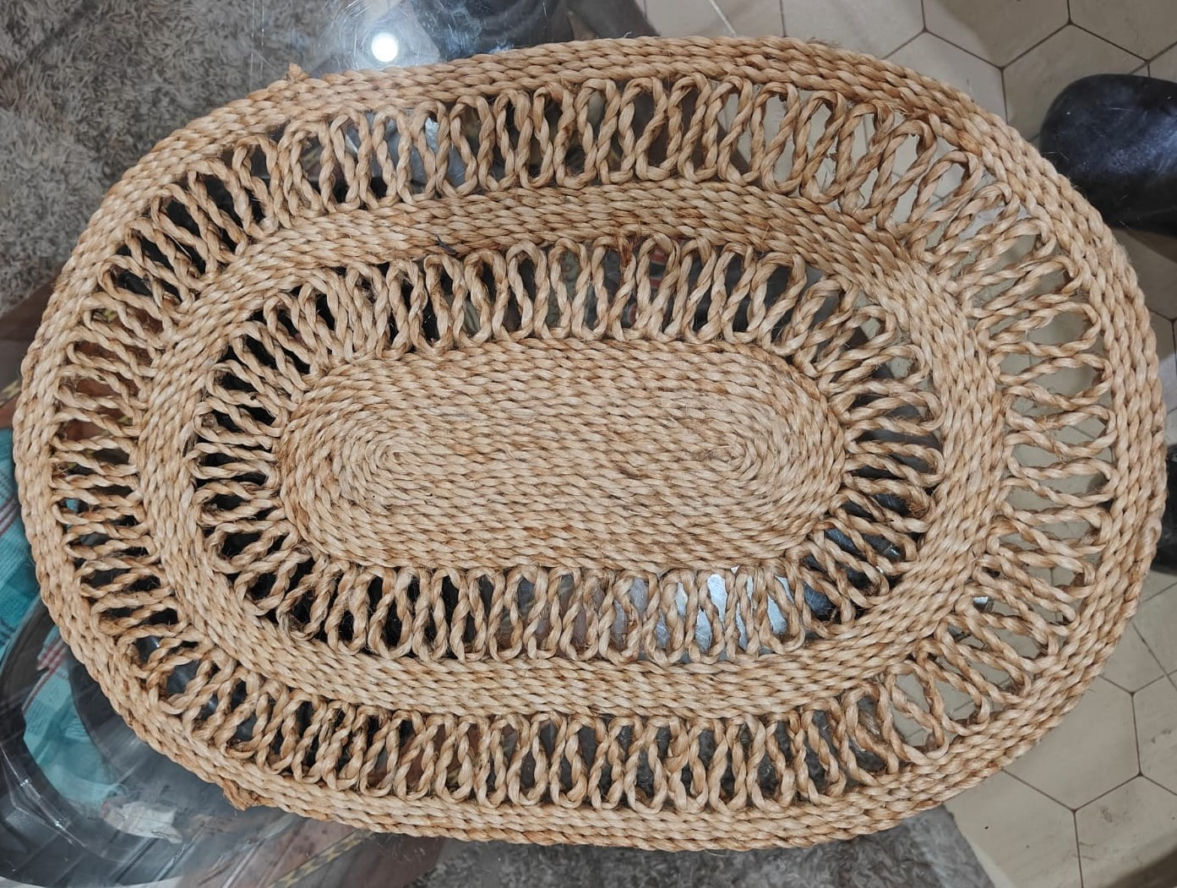
HANDMADE JUTE RUGS
PRODUCT CODE : MKT-1213
TYPE - PLACEMAT
SIZE - 13 - 15 INC
MATERIAL :- 100% JUTE
100% HAND STITCHED
WE CAN MAKE CUSTOM DESIGN,COLOUR AND SIZE

Slide 17
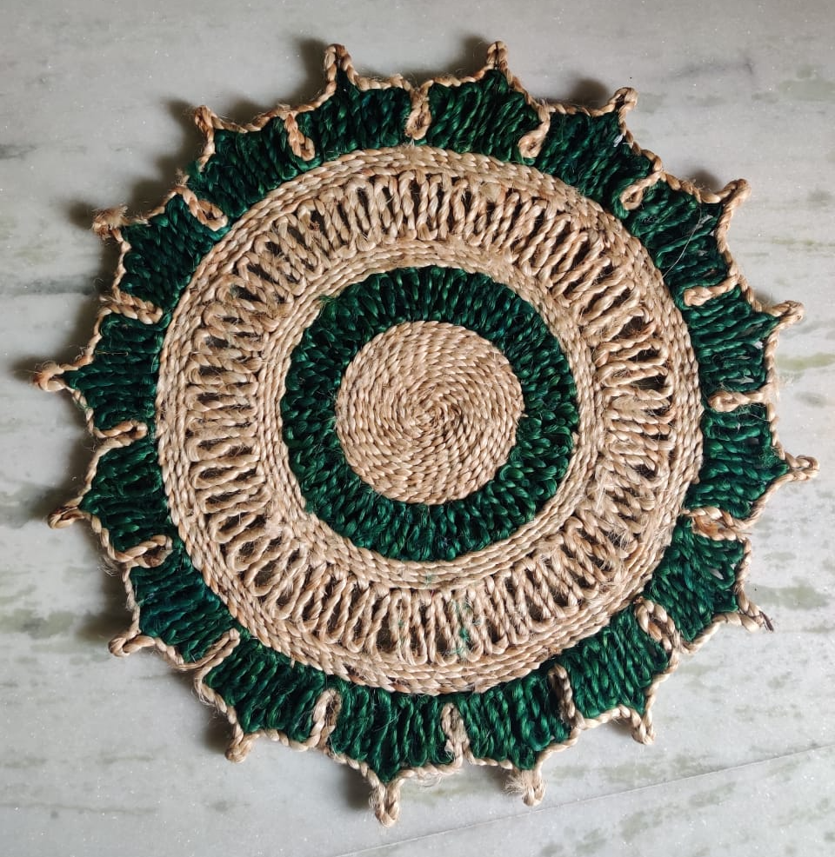
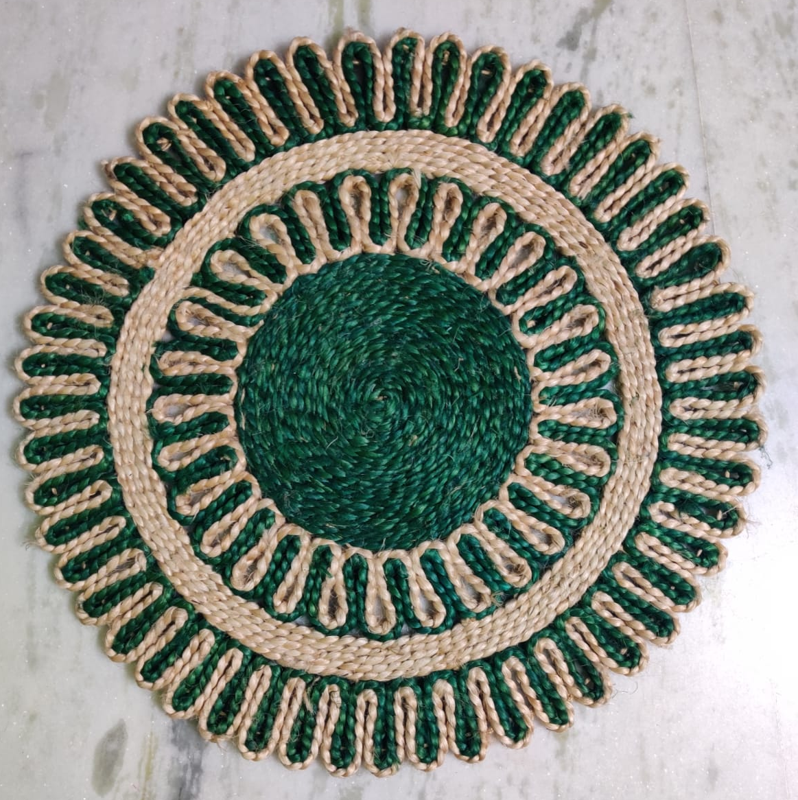
HANDMADE JUTE RUGS
PRODUCT CODE : MKT-1213
TYPE - PLACEMAT
SIZE - 13 - 15 INC
MATERIAL :- 100% JUTE
100% HAND STITCHED
WE CAN MAKE CUSTOM DESIGN,COLOUR AND SIZE

Slide 18
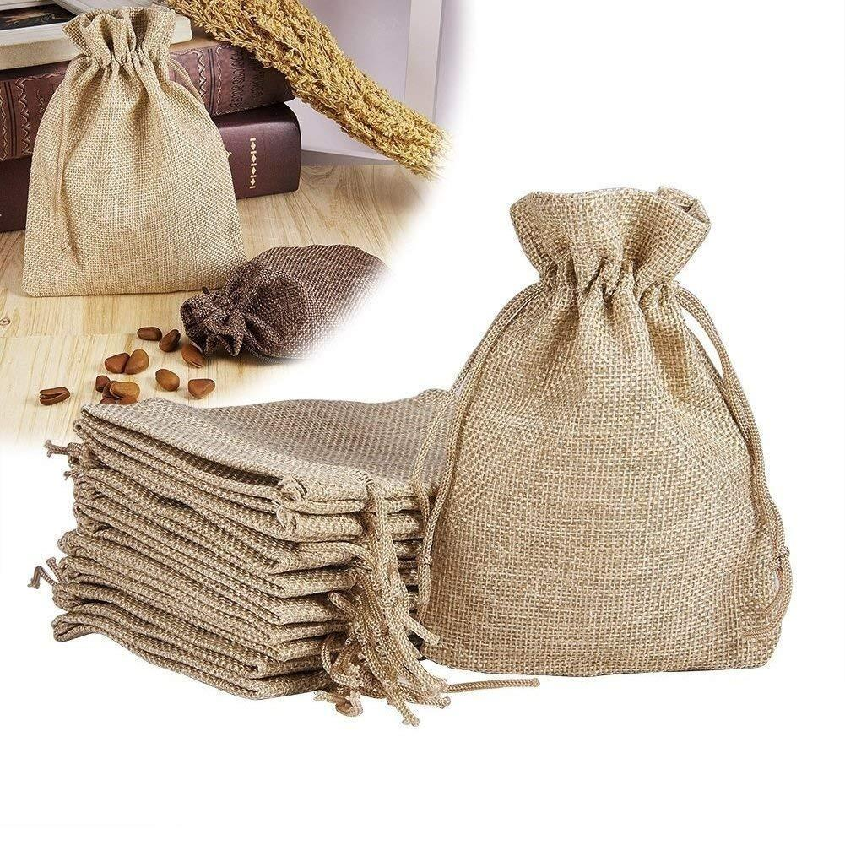
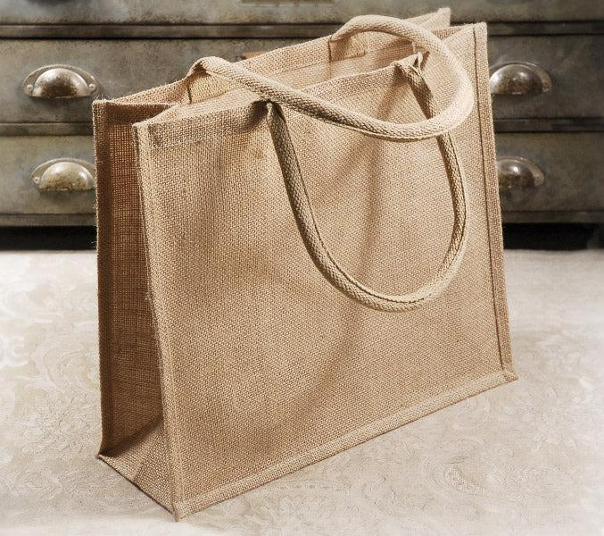
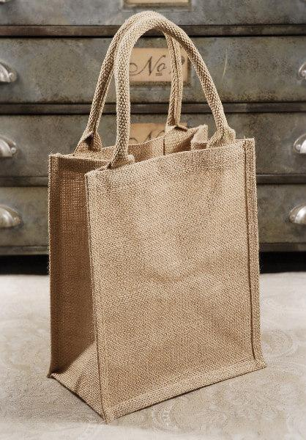
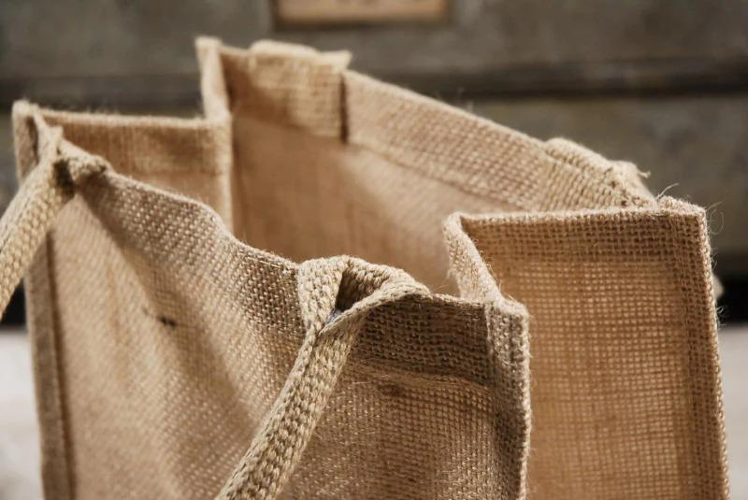
JUTE BAGS
PRODUCT CODE : MKT-1260
TYPE - BAGS & POUCH
MATERIAL :- 100% JUTE
WE CAN MAKE CUSTOM DESIGN,COLOUR AND SIZE

